Slide 1


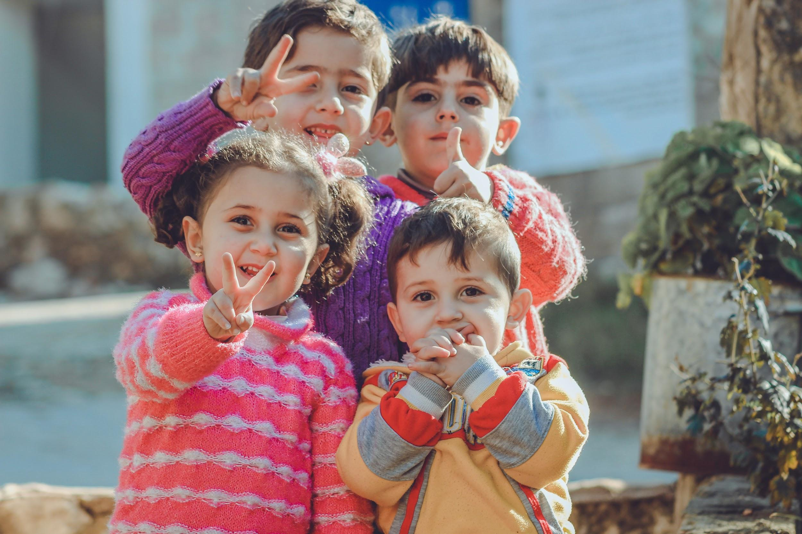

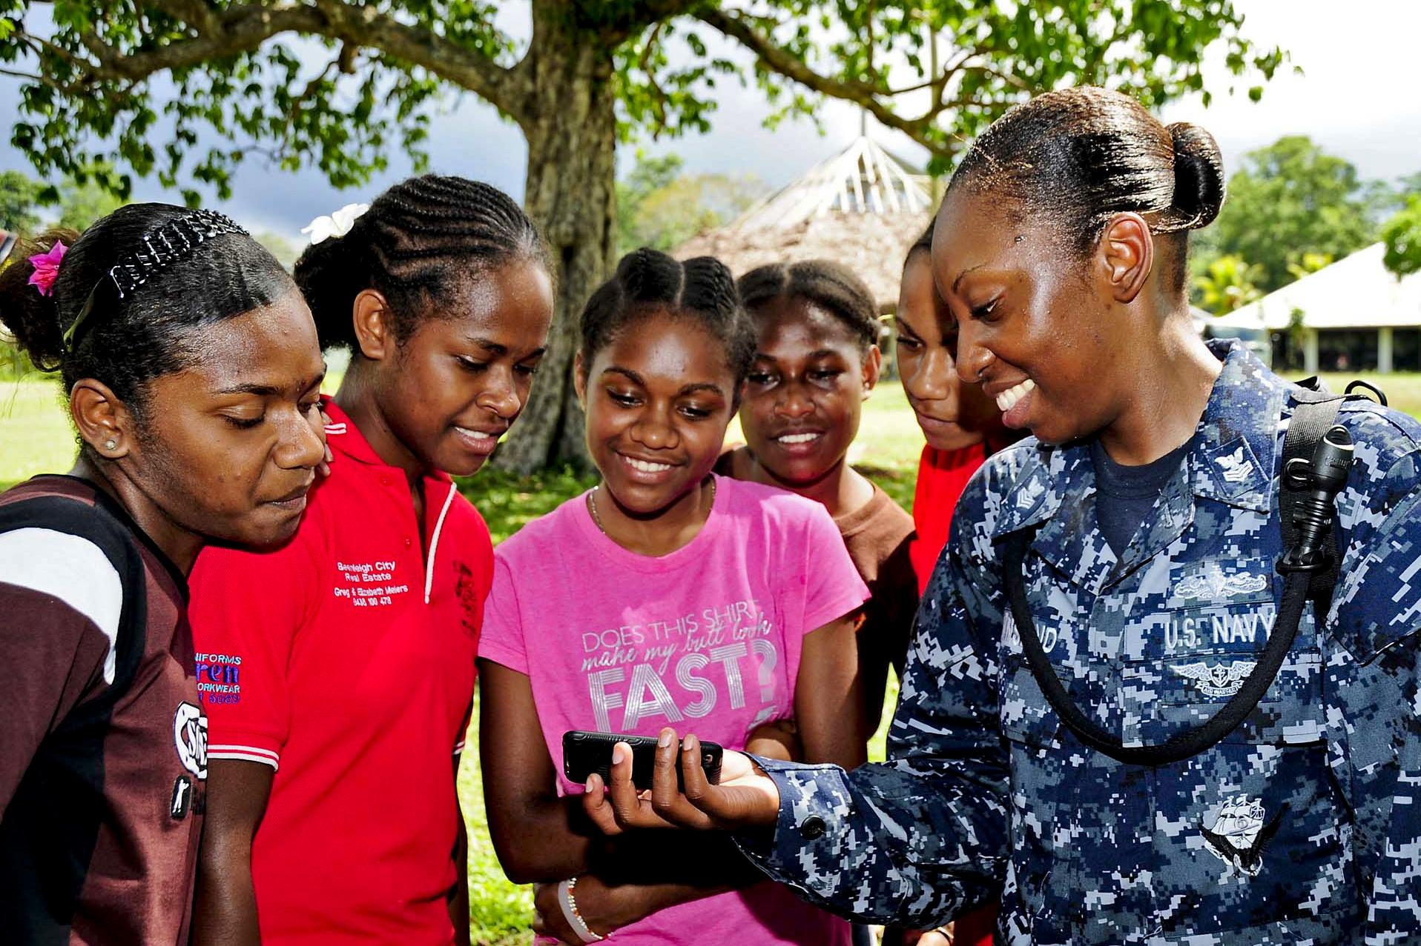
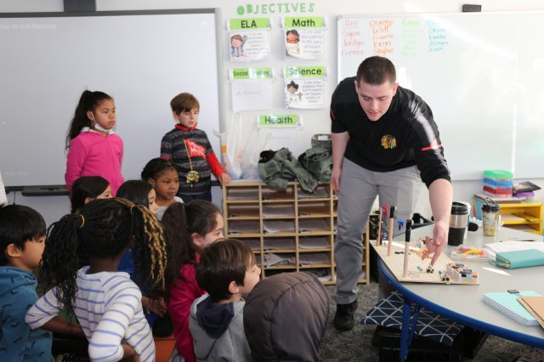
Issues that affect child/adolenscent today
Poverty
Health ,Safety and Environment
Lack of good qualified teachers
Technology and distractions
Peer pressure and career choices
Michigan Teachers of tomorrow By : Pranjali Pandya
Project 6 Part 2 : Sept 18 2019

Slide 2

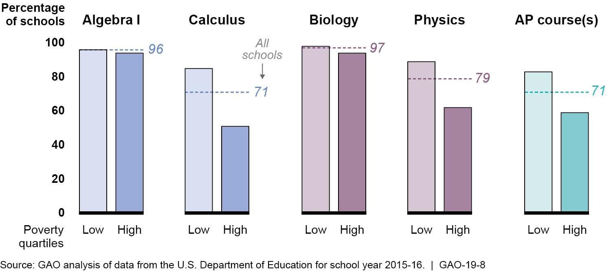
Issues that affect child/adolenscent today: Poverty
Michigan Teachers of tomorrow By : Pranjali Pandya
Project 6 Part 2 : Sept 18 2019
Root cause of most of the issues.
Directly affects classroom engagement
Knowledge acquisition becomes difficult
Lack of resources takes away motivation
Impacts overall wellbeing and learning environment
Affects social and emotional state of students
Hard to get out of the cycle
Significant difference in living conditions
Demands high level of community engagement
Demands parental/adult involvement.
Resources for Teachers, Parents and Students
How to help students
Child fund International
Global Issue
Michigan Teachers of tomorrow By : Pranjali Pandya
Project 6 Part 2 : Sept 18 2019

Slide 3


Issues that affect child/adolescent today
Health ,Safety and Environment
Positive class environment promotes health and safety
Schools with lack of resources fail to provide healthy lunch options
Reasons health and safety are important
Teaching non violence and empathy to promote positive school climate
Schools and districts suffer without positive behavioral intervention support
Promote Students’ physical and mental health
  Provide mentorship
  Healthy active lifestyle and nutrition education
  Substance abuse prevention and chronic disease management
  Bullying prevention and relationship building skills
High school dropout prevention
Prevention of abuse , neglect and school readiness and academic success.
Ways to implement : video
Resources for Teachers, Parents and Students
1.Education World 3. Classroom Tips 5. Whole child approach
2. Educational Leadership 4. Safe Supportive Learning Environment
Michigan Teachers of tomorrow By : Pranjali Pandya
Project 6 Part 2 : Sept 18 2019

Slide 4

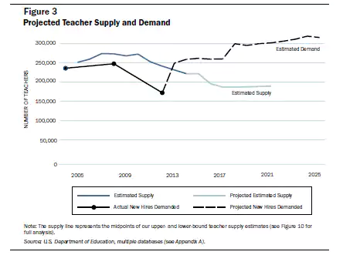
Issues that affect child/adolescent today
Lack of good qualified teachers
Shortage of qualified teachers in US
Effects on class size and teacher student ratio
Gifted students don’t get recognized
Absence of differentiating instructions and best practices
Decrease in students’ knowledge acquisition and advancement
It affects students’
  Critical thinking ability and advance enrichment practices
  Enrollments in acceleration programs
  Overall performance esp. from low income families
  Overall performance, the district ratings and community education
Teacher pay gap and scarcity of effective professional development
Resources for Teachers, Parents and Students
Publication by Emma Garcia
Report by Tim Walker
Book :Keeping good teachers
Michigan Teachers of tomorrow By : Pranjali Pandya
Project 6 Part 2 : Sept 18 2019

Slide 5


Issues that affect child/adolescent today:Technology and Distractions
World Wide use of technology
Unavoidable connections causes distractions
Less facetime Vs more screen time
Equal and opposite sets of possible disadvantages with a set of advantages
Difficult to find the right balance between the teacher facetime and the use of technology during direct instructions.
Problems in banning technology in the class and the use of assistive technological devices for special population.
Digital Citizenship :
Resources for Teachers, Parents ad Students
Publication by Derek Bok 3. Apps for Students
Tips for Parents 4. Digital Citizenship
Michigan Teachers of tomorrow By : Pranjali Pandya
Project 6 Part 2 : Sept 18 2019

Slide 6


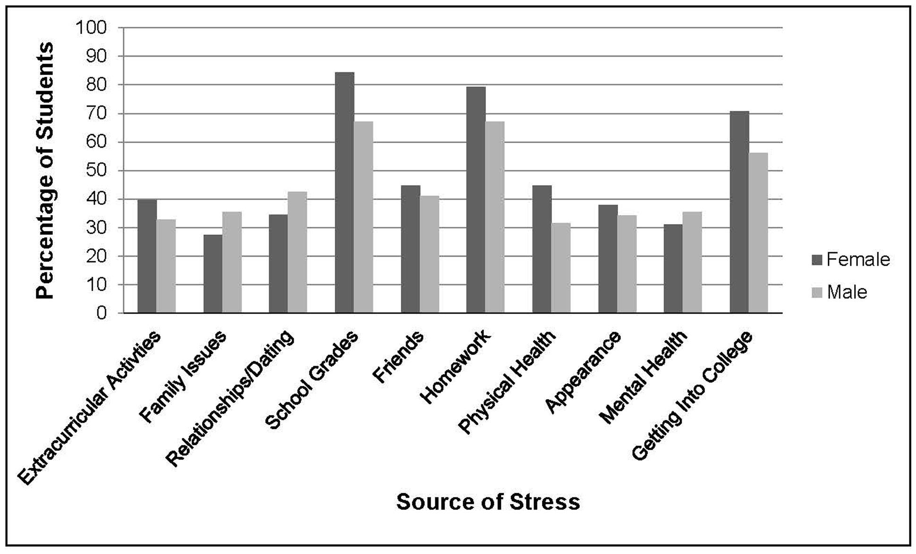
Issues that affect child/adolescent today:Peer pressure and career choices
Peer pressure starts at an early age : video ---------->
Stress due to social and parental pressure
Effects on classroom learning experience
Higher parental expectations and use of adgets and advancement in technology
Increase of stress management in classroom teaching
Pros and Cons of less interaction with people and increased social media presence
New trends in careers and fierce competition: Career Options
Universities demand top grades but degree doesn’t guarantee employment
Awareness of the issue and setting realistic goals for young minds
Resources for Teachers, Parent and Students
Tips for everyone
Classroom Management
Educational Psychology
Michigan Teachers of tomorrow By : Pranjali Pandya
Project 6 Part 2 : Sept 18 2019

